Slide 1
Daily Paper Reading
Wendong Chen
22/01/2019

Slide 2
Visualizing and Understanding Convolutional Networks
Topic:
Background;
Training;
Visualization;
Analysis;
Experiments.

Slide 3
Background
CNN:
Impressive classification performance;
Availability
Powerful GPU implementations
Regularization
Black box;
How and Why?
Visualization

Slide 4
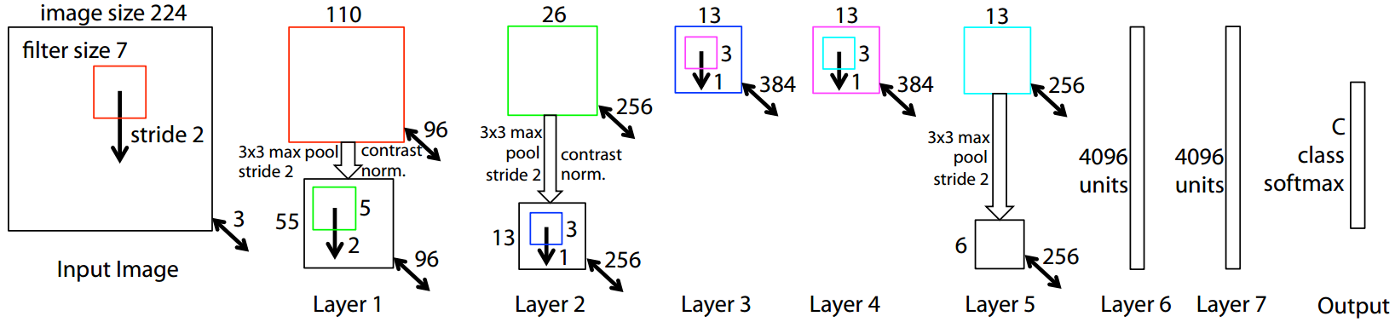
Training
Training set: 1.3 million images, 1000 classes;
Pre-processing: resize to 256*256, subtract mean RGB values, sub-crop to 224*224;
Method: SGD, momentum, Dropout;
Batch size: 128.

Slide 5
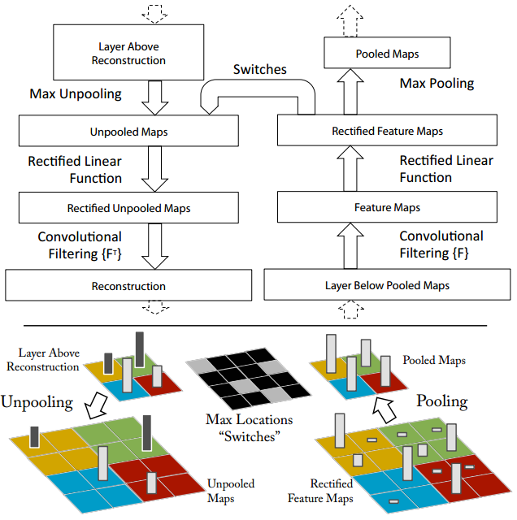
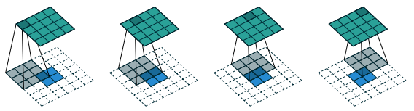
Visualization
Deconvnet:
Unpooling;
“Switch”
Rectification;
Filtering.
Transposed filters

Slide 6
Analysis
Feature visualization;
Feature evolution;
Feature invariance;
Architecture selection;
Occlusion sensitivity;
Correspondence analysis.

Slide 7
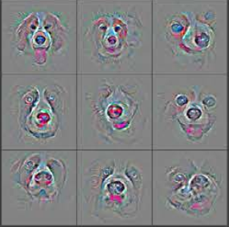
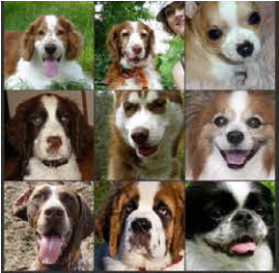
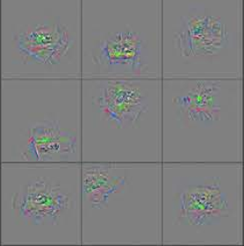
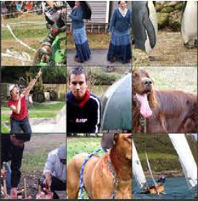
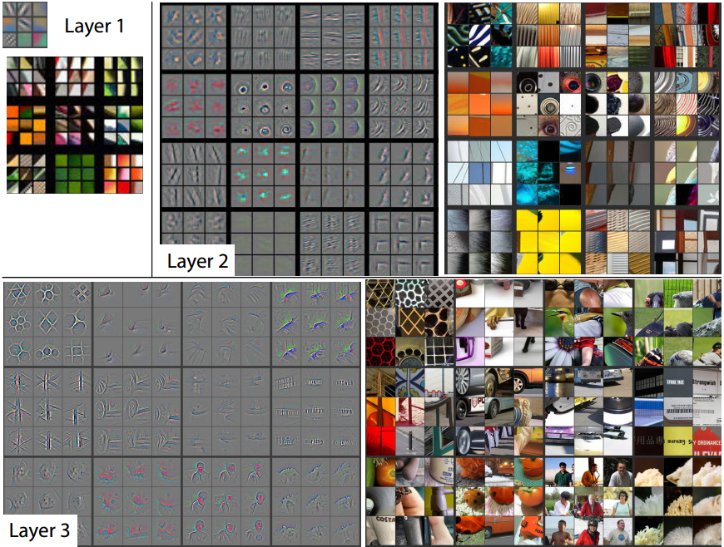
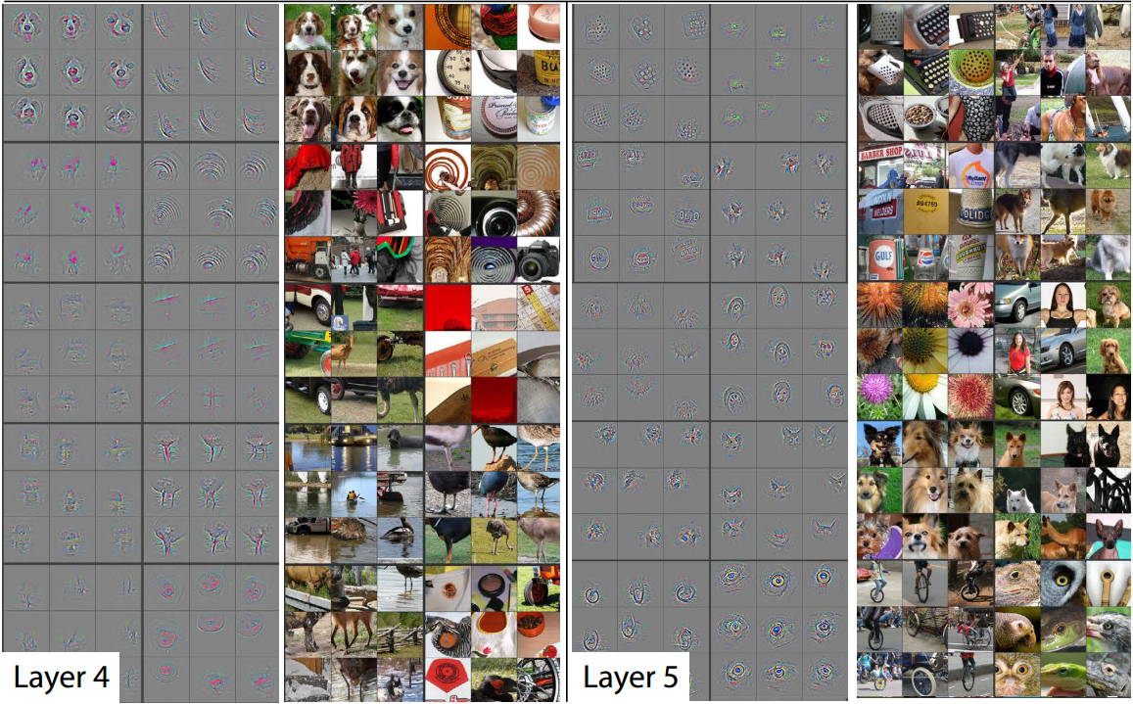
Analysis
Feature visualization

Slide 8
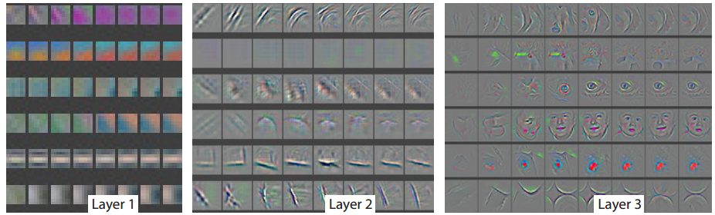
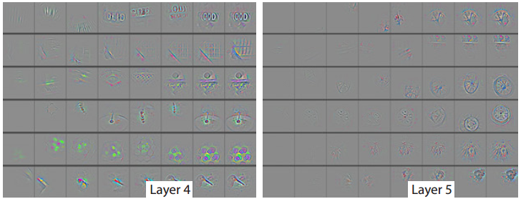
Analysis
Feature evolution
Higher layer, slower convergence.

Slide 9
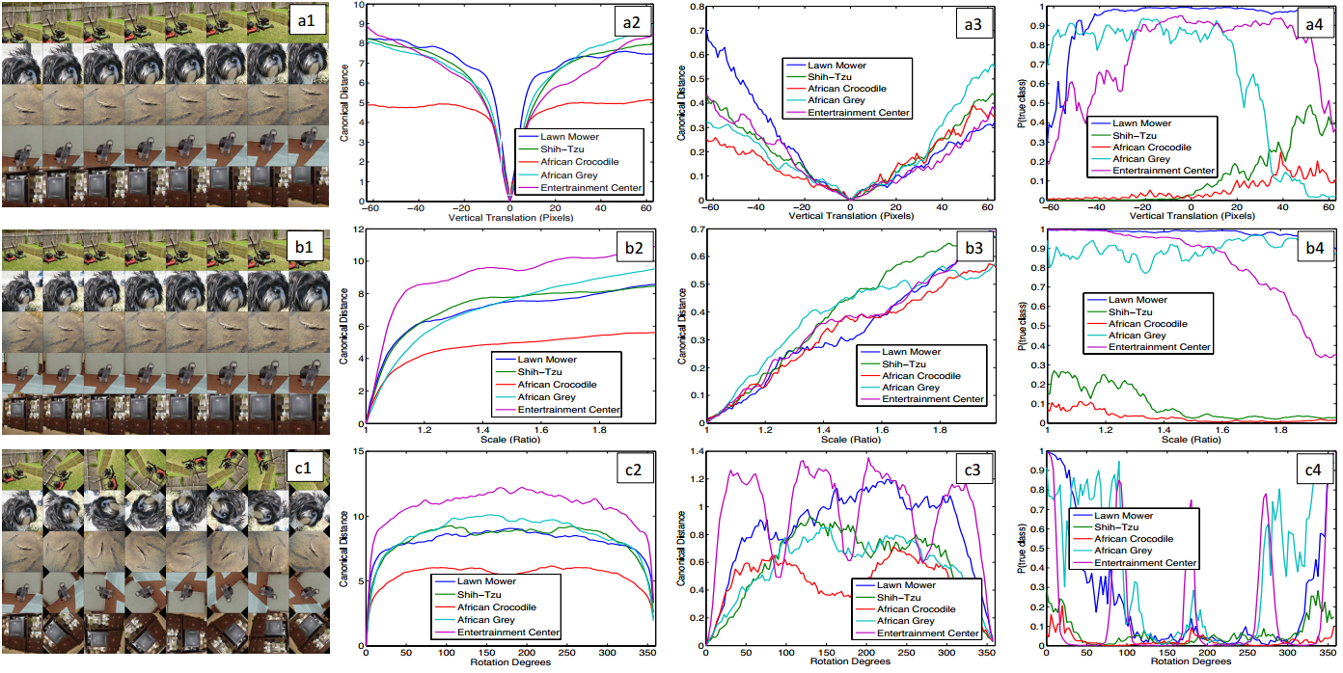
Analysis
Feature invariance
Higher layer, better invariance.
a: vertical translation
b: scale
c: rotation
col 2: layer 1
col 3: layer 7

Slide 10
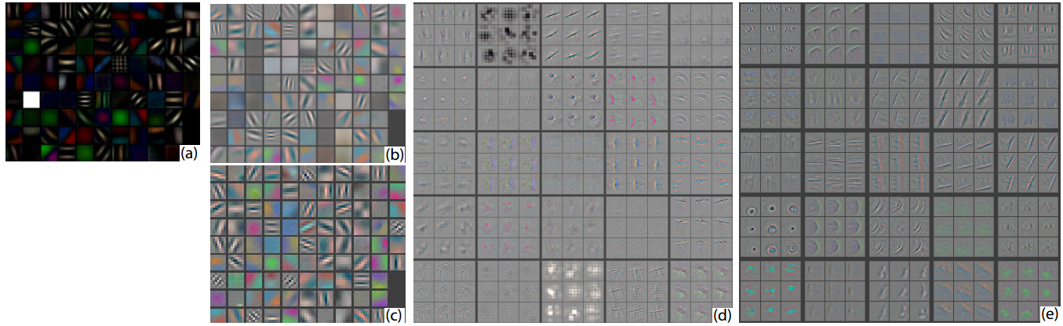
Analysis
Architecture selection
Smaller stride and filter size
More distinctive features, fewer “dead” features, no aliasing artifacts

Slide 11
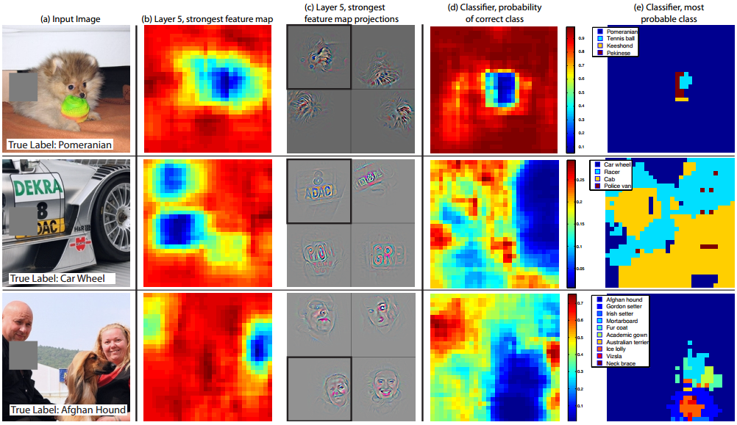
Analysis
Occlusion sensitivity

Slide 12
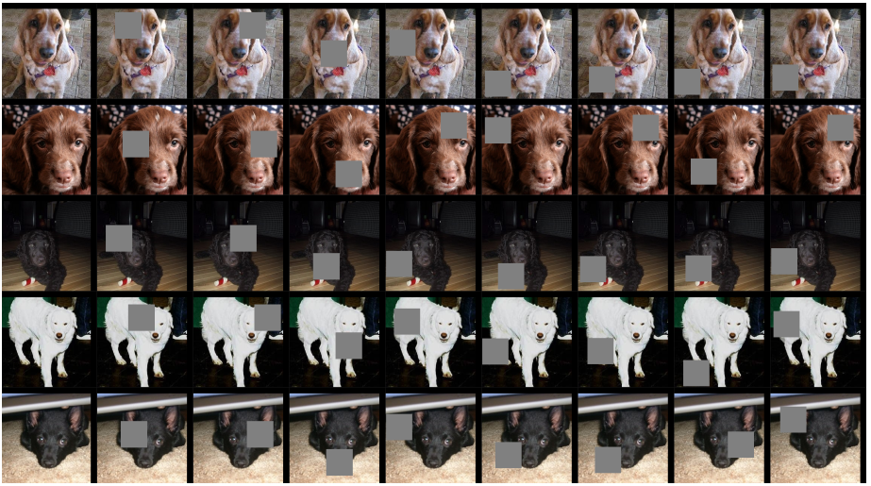
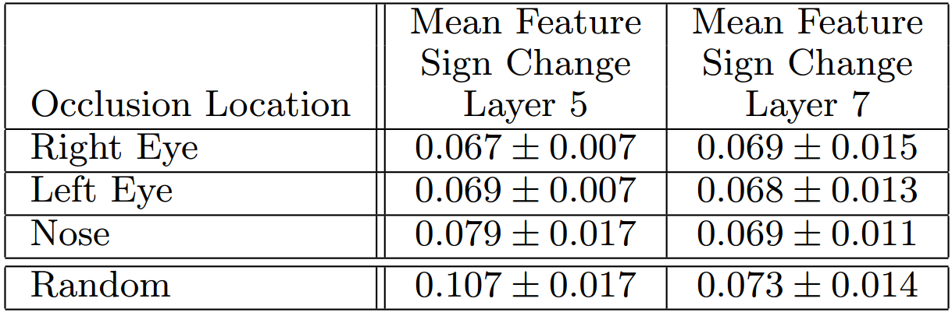
Analysis
Correspondence analysis
Models might implicitly establish correspondence between specific object parts in different images.

Slide 13
Experiments
Model size;
Feature generalization.
Deeper depth, larger training set

